Slide 1
Movie Recommendation System.
Presented By: Dnyaneshwar Ainar

Slide 2
What are recommender systems?
Recommender systems aim to predict users interests and recommend product items that quite likely are interesting for them. They are among the most powerful machine learning systems used by online retailers to increase sales.
A recommendation system is a Information filtering Systems that seeks to predict the rating or the preference a user might give to an item. In simple words, it is an algorithm that suggests relevant items to users.
E.g.: In the case of Netflix which movie to watch, In the case of e-commerce which product to buy, or In the case of kindle which book to read, etc.

Slide 3
With the rise of YouTube, Amazon, Netflix, and other similar web services over the last few decades, recommender systems have become more important in our lives. From e-commerce to online advertising, recommender systems are now uncontrollable in our daily online journeys.
Data for recommender systems is derived from explicit user ratings after watching a movie or listening to a song, implicit search engine queries and purchase histories, or other information about the users/items themselves.

Slide 4
Why do we need recommender systems?
Recommender systems are extremely important in some industries because they can generate a significant amount of revenue when they are efficient or serve as an opportunity to differentiate significantly from competitors.
As evidence of the importance of recommender systems, a few years ago, Netflix organised a challenge (the "Netflix prize") in which the goal was to create a recommender system that outperformed its own algorithm, with a prize of $1 million to be won.
Companies using recommender systems focus on increasing sales as a result of very personalized offers and an enhanced customer experience.

Slide 5
Recommendations typically speed up searches and make it easier for users to access content they’re interested in, and surprise them with offers they would have never searched for.
What is more, companies are able to gain and retain customers by sending out emails with links to new offers that meet the recipients' interests, or suggestions of films and TV shows that suit their profiles.
The user starts to feel known and understood and is more likely to buy additional products or consume more content. By knowing what a user wants, the company gains competitive advantage and the threat of losing a customer to a competitor decreases.

Slide 6
How does a recommender system work?
Three algorithms used in recommender systems:
Content-based systems, which use characteristic information.
Collaborative filtering systems, which are based on user-item interactions.
Hybrid systems, which combine both types of information with the aim of avoiding problems that are generated when working with just one kind.

Slide 7
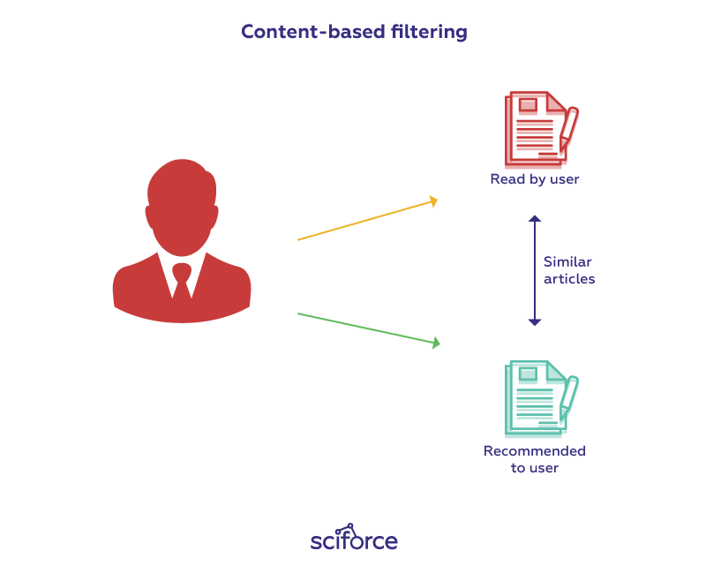
1.Content-based systems
A content-based recommender uses data provided by the user, either explicitly (rating) or implicitly (clicking on a link). Based on that information, a user profile is created, which is then used to make recommendations to the user. The engine becomes more accurate as the user provides more inputs or acts on the recommendations.

Slide 8
Advantage
Model doesn’t need data of other users since recommendations are specific to a single user.
The model can Capture the specific Interests of the user and can recommend items that very few other users are interested in.
Disadvantage
Feature representation of items is hand-engineered to some extent, this tech requires a lot of domain knowledge.
The model can only make recommendations based on the existing interest of a user. In other words, the model has limited ability to expand on the user’s existing interests.

Slide 9
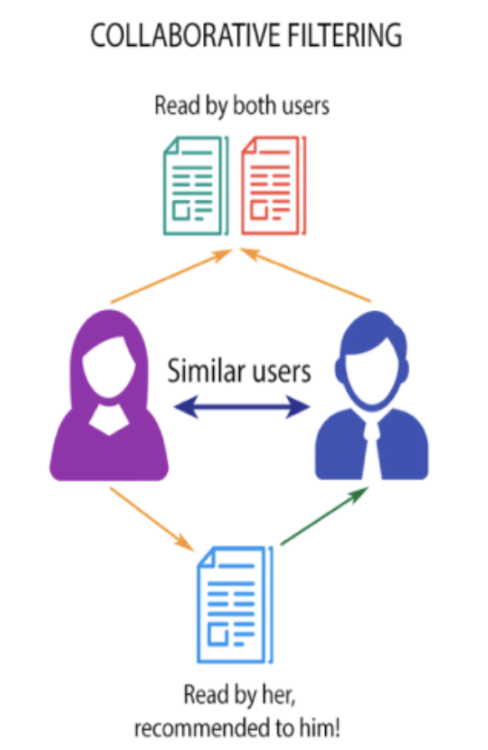
2. Collaborative Filtering
Collaborative-based filtering is nothing but Recommending the new items to users based on the interest and preference of other similar users.
Collaborative filtering is currently one of the most frequently used approaches and usually provides better results than content-based recommendations.

Slide 10
Some examples of this are found in the recommendation systems of YouTube, Netflix, and Spotify.
In short, collaborative filtering systems are based on the assumption that if a user likes item A and another user likes the same item A as well as another item, item B, the first user could also be interested in the second item. Hence, they aim to predict new interactions based on historical ones.

Slide 11
Advantage
It works well even if the data is small.
This model helps the users to discover a new interest in a given item but the model might still recommend it because similar users are interested in that item.
Disadvantage
It cannot handle new items because the model doesn’t get trained on the newly added items in the database.

Slide 12
Approach
Below mention are the steps involved in the completion of this project :
Data collecting
Data cleaning
EDA
Text Preprocessing
Feature Extraction
Model Building
Model Deployment

Slide 13
Data collecting
Dataset is downloaded from Kaggle.com. ( Kaggle is an online community platform for data scientists and machine learning enthusiasts. Kaggle allows users to collaborate with other users, find and publish datasets, use GPU integrated notebooks, and connect with other data scientists to solve data science challenges. )
About Datasets:
There are two dataset I’m using for this project.

Slide 14
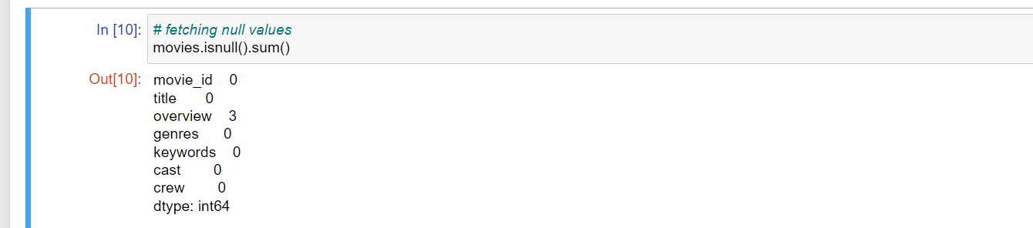
Data cleaning
Dataset not contain only few null values and does not have any duplicate value.

Slide 15
Exploratory Data Analysis (eda)
Exploratory Data Analysis (EDA) is an approach to analyze the data using visual techniques. It is used to discover trends, patterns, or to check assumptions with the help of statistical summary and graphical representations.
The main purpose of EDA is to help look at data before making any assumptions. It can help identify obvious errors, as well as better understand patterns within the data, detect outliers or anomalous events, find interesting relations among the variables.

Slide 16
Visualizing using word cloud
Word Cloud is a data visualization technique used for representing text data in which the size of each word indicates its frequency or importance.
It shows the popularity of words or phrases by making the most frequently used words appear larger or bolder compared with the other words around them

Slide 17
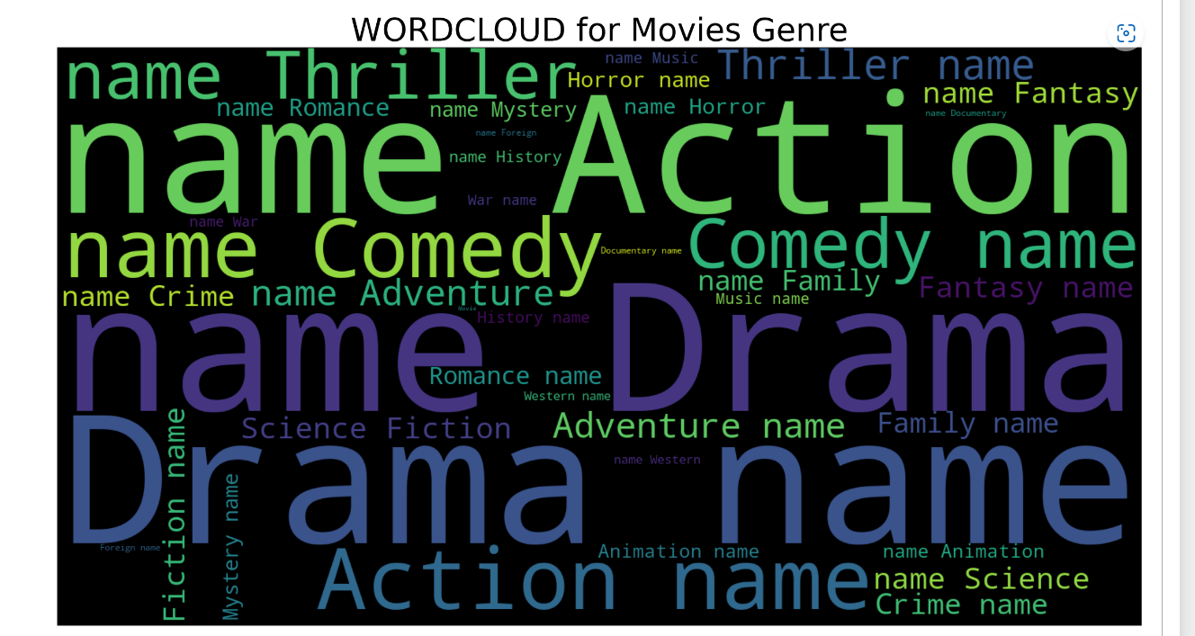
Visualizing genres of movie. It highlighting which type of movie is frequently occurring.

Slide 18
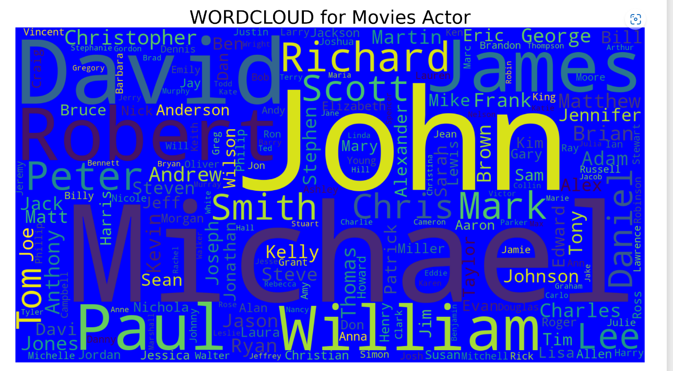
Visualizing Actors of movie. It highlighting which actor has done the most movies.

Slide 19
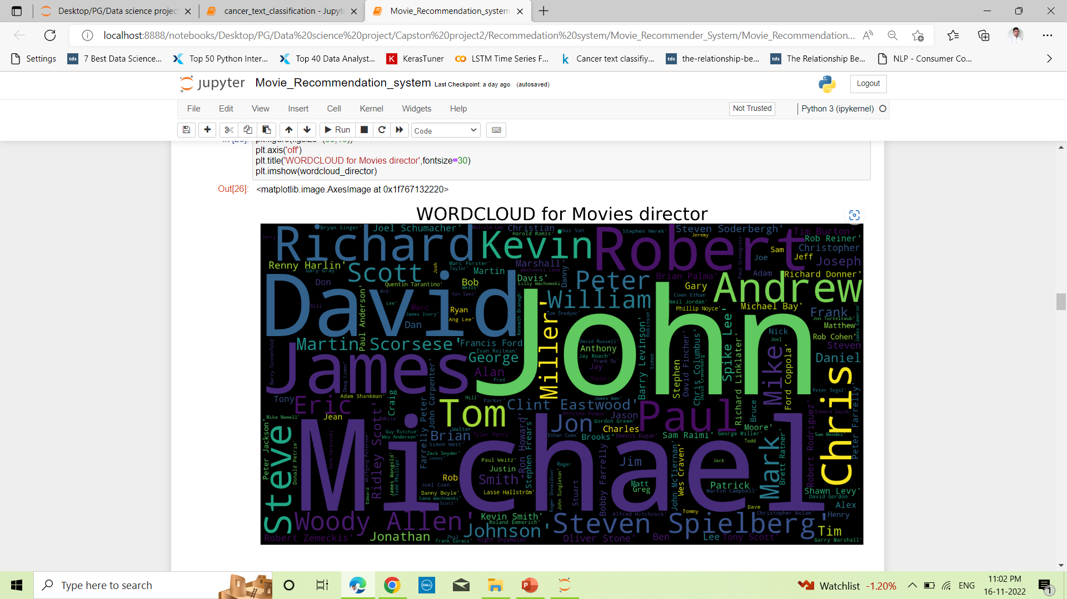
Visualizing directors of movie. It highlighting which director has done the most movies.

Slide 20
Feature extraction
Machines cannot understand characters and words. So when dealing with text data we need to represent it in numbers to be understood by the machine
Count-vectorizer is a method to convert text to numerical data.. It is used to transform a given text into a vector on the basis of the frequency (count) of each word that occurs in the entire text. This is helpful when we have multiple such texts, and we wish to convert each word in each text into vectors.

Slide 21
Model Building
Model building using cosine similarity:
Cosine similarity is the cosine of the angle between two vectors and it is used as a distance evaluation metric between two points in the plane. The cosine similarity measure operates entirely on the cosine principles where with the increase in distance the similarity of data points reduces.
finding the similarity of movies using cosine similarity. The cosine of the angle of two vectors projected in a multidimensional space is shown by cosine similarity.

Slide 22
Recommendation systems in machine learning are one such algorithm that works based on the similarity of contents. There are different methods for measuring the similarity of two materials, and recommendation systems depend on the similarity matrix to recommend similar content to the user based on his accessing habits.

Slide 23
Model deployment
Model deployment is the process of putting machine learning models into production. This makes the model's predictions available to users, developers or systems, so they can make business decisions based on data, interact with their application (like recognize a face in an image) and so on.
I have deployed model on Heroku using streamlit framework.
Heroku is a cloud Platform as a Service (PaaS). We can use Heroku to deploy, manage, and scale modern apps. Heroku platform is flexible, and easy to use, offering developers the simplest path to getting their apps to market.
Streamlit is an open-source Python library that makes it easy to create and share beautiful, custom web apps for machine learning and data science. In just a few minutes you can build and deploy powerful data apps.

Slide 24
Thanking you…

